Slide 1
Machine Learning
Exercise

Slide 2
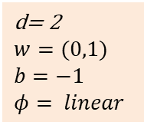
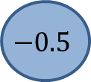
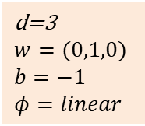
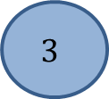
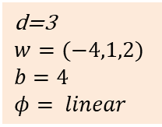
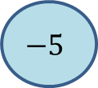
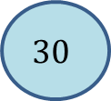
A simple Neural Network
$$30$$
$$3$$
d=3
$$w=(−4,1,2)$$
$$b=4$$
$$φ= linear$$
20
2
d= 2
$$w=(0,1)$$
$$b=−1$$
$$φ= linear$$
d=3
$$w=(0,1,0)$$
$$b=−1$$
$$φ=linear$$
$$−5$$
$$−0.5$$

Slide 3
A simple Neural Network
$$30$$
$$3$$
d=3
$$w=(−4,1,2)$$
$$b=4$$
$$φ= linear$$
20
2
d= 2
$$w=(0,1)$$
$$b=−1$$
$$φ= linear$$
d=3
$$w=(0,1,0)$$
$$b=−1$$
$$φ=linear$$
$$−5$$
$$−0.5$$

Slide 4
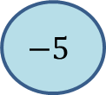
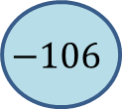
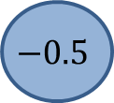
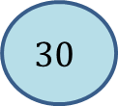
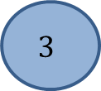
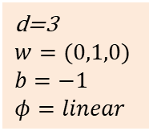
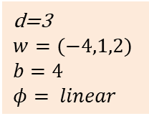
Solution
$$30$$
$$3$$
d=3
$$w=(−4,1,2)$$
$$b=4$$
$$φ= linear$$
$$−106$$
-7
20
2
d=3
$$w=(0,1,0)$$
$$b=−1$$
$$φ=linear$$
19
1
$$−5$$
$$−0.5$$
$xw+b=\left(−4⋅30+1⋅20− 2⋅5\right)+4=−106$
$xw+b=\left(−4⋅3+1⋅2− 2⋅0.5\right)+4=−7$

Slide 5
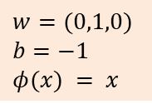
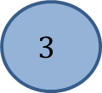
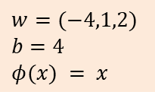
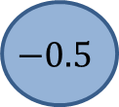
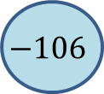
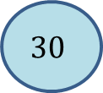
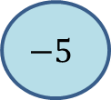
Note the Matrix view: Features are rows!
Input
Array of shape (2,3)
Output
Array of shape (2,2)
$$w=(−4,1,2)$$
$$b=4$$
$$φ(x) = x$$
$$30$$
20
$$−5$$
$$−106$$
19
Network
$$3$$
2
$$−0.5$$
-7
1
$$w=(0,1,0)$$
$$b=−1$$
$$φ(x) = x$$

Slide 6

Dense Layer as Matrix-Multiplication (ignore Activation for a moment)
$$X= \left(\begin{matrix}30 & 20 & −5 & 1 \\ 3 & 2 & −0.5 & 1\end{matrix}\right), X∈ ℝ^{n×(d+1)}$$
$W = \left(\begin{matrix}−4 & 0 \\ 1 & 1 \\ 2 & 0 \\ 4 & −1\end{matrix}\right), W∈ ℝ^{\left(d+1\right)×l}$
$X⋅W= \left(\begin{matrix}3 & 2 & −0.5 & 1 \\ 30 & 20 & −5 & 1\end{matrix}\right)⋅$ $\left(\begin{matrix}−4 & 0 \\ 1 & 1 \\ 2 & 0 \\ 4 & −1\end{matrix}\right)$ = $\left(\begin{matrix}−7 & 1 \\ −106 & 19\end{matrix}\right)$

Slide 7
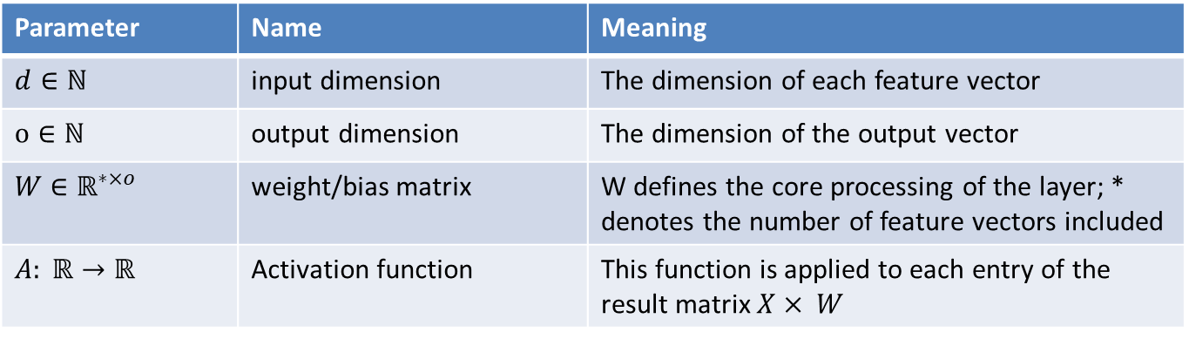
Dense Layer
A Dense Layer at this stage is defined by the following parameters:
Parameter | Name | Meaning
$d∈ℕ$ | input dimension | The dimension of each feature vector
$$o∈ℕ$$ | output dimension | The dimension of the output vector
$W$ $∈ℝ^{∗×o}$ | weight/bias matrix | W defines the core processing of the layer; * denotes the number of feature vectors included
$$A: ℝ→ℝ$$ | Activation function | This function is applied to each entry of the result matrix $X× W$

